Slide 1
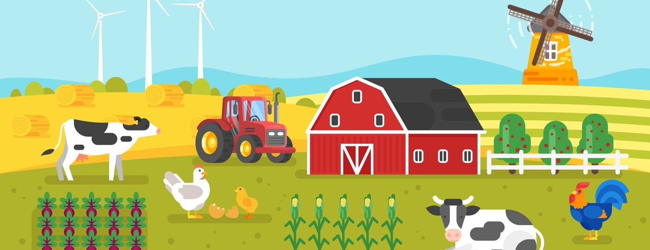
Productive Options for Farmers
SOUTH Region (NUTS2 Alentejo+Algarve)
Nélia Sequeira, Aura Bustillo, Yvette Ramos, Johanna Jeukendrup, Marise Almeida
Theories and Practices in Sustainable Development
PhD In Climate Change and Sustainable Development Policies
2021/2022

Slide 2
Topics
Framework and Objetives
Data and Methods
Results

Slide 3
Framework and Objetives
Framework

Slide 4
Framework and Objetives
Objetives
Identify the productive options available to farmers in South Region NUTS 2 Alentejo and Algarve by identifying agricultural production systems (SPA) on farms in that area;
2. Characterize each of these SPA in terms of:
productive intensity (land productivity),
(2) working capacity (worked area per unit of work),
(3) labor productivity,
(4) level of productive specialization,
(5) pattern of productive specialization,
(6) livestock density,
(7) composition of livestock, and
(8) use of agricultural area;
(9) fraction of the territory occupied by agriculture;
3. Interpret the technology reflected in these production systems, positioning them in relation to the equation:
labor productivity = (earth productivity) VPPT x (area per unit of work)
4. Analyze the effect of several variables (exogenous to the choice of agricultural production system), biophysical or socio-economic, which condition/direct the choice of the farmer among the various possible SPA (driver analysis);

Slide 5
Data and methods
Building the farming system typology
- Get the data: “IFAP-Type data”
-Define relevant land use and livestock variables:
(1) Productive intensity (production per hectare of land): VPPT / S.A.U. (Euros per hectare); Total CN / S.A.U. (total livestock units per hectare)
(2) Level and pattern of specialisation; Arable land/S.A.U.(fraction); Permanent crops/S.A.U.(fraction); Pasture and permanent grassland/S.A.U.(fraction); CN Bovine /Total CN (fraction); CN Sheep/total CN(fraction); CN Goat/CN total (fraction); CN Equidae /CN Total (fraction); S.A.U. occupied by OTEj/S.A.U.
(3) Human labour dependency (area worked per labour unit): S.A.U./UTA (hectares per agricultural work unit)
- Run a Cluster Analysis: SPSS and choose the number of clusters that best fits our data, using visual dendogram analysis (SPSS) and statistical analysis (Statistics-Eta Square and Confidence Intervals Graph)

Slide 6
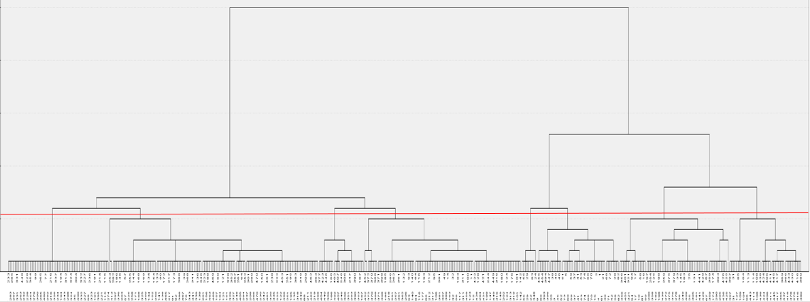
Results- Identify agricultural production systems
Hierarchical Cluster Analysis - Dendogram

Slide 7
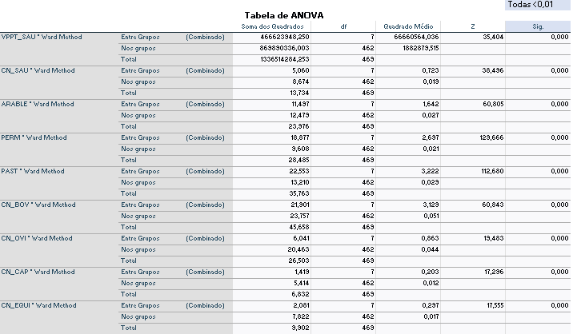
Results-Analysis of Variance (ANOVA) for 8 clusters
The results are statistically significant for all variables (<1%)

Slide 8
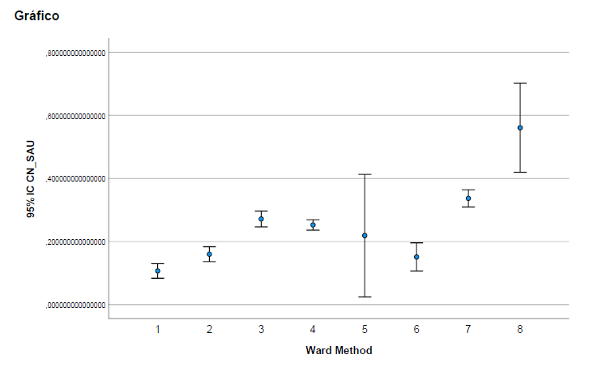
Statistics-Eta Square and Confidence Intervals Graph

Slide 9
Results- Characterization of each FS (I)
Intensity, Land use, Livestock, Productive orientation of the farms
Note: According to data from INE (RGA 2009) the Alentejo accounts for 39% of national bovine production, almost exclusively directed towards meat production.
The concentration of bovine livestock on large farms (138.4 heads/farm).

Slide 10
Results- Characterization of each FS (II)
Intensity, Land use, Livestock, Productive orientation of the farms

Slide 11
Results- Characterization of each FS (III)
Cluster 1 (n=49)
Cluster 2 (n=65)
Cluster 3 (n=93)
1. Identification
Medium Intensity
Permanent culture 72%
Sheep 48%, birds 20%
Specialized fruits (Fresh 29%, citrus 21% ,nuts 21%)
2. ANOVA Drivers
70% of land < 8% decline
Average altitude: 56 M
Soil: 30% high value, 25% variable,32% reduced value
Precipitation: 527 mm/year
Average Temperature: 17,1 ºC
Water availability: 39%
Average farm size: 6 Ha
3. Labor productivity/year: 10 479 €
1. Identification:
Medium Intensity
Permanent culture 46%, arable 33%
Bovines 33% , Sheep 37%
2. ANOVA Drivers:
49% of land >16% decline
Average altitude: 205M
Soil: 64 % reduced value
Precipitation: 583 mm/year
Average temp 16,6 ºC
Water availability: 8%
Average farm size: 7,5 Ha
3. Labor productivity/year: 13 769 €
1. Identification
low Intensity
Arable land 43%
Bovines74%, specialized 22%
Mixed crop livestock 25%
2. ANOVA drivers
68% of land < 8% decline; 22% between 8% and 16%
Average altitude 192 M
Soil:44% high value,34% reduced
Precipitation: 612 mm/year
Average temp: 16,2 C
Water availability 8%
Average farm size 90 Ha
3. Labor productivity/year:32 949 €

Slide 12
Results- Characterization of each FS (III)
Cluster 4 (n=124)
Cluster 5 (n=9)
Cluster 6 (n=43)
1. Identification:
low Intensity
Pasture 60%
Bovines 58% sheep 34%, specialized bovines 24%
2. ANOVA drivers:
41% of land < 8% decline; 34% >16%
Average altitude: 262 M
Soil: 74% reduced value
Precipitation: 665 mm/year
Average Temperature: 16ºC
Water availability:4%
Average farm size: 48 Ha
3. Labor productivity/year: 21 767 €
1. Identification:
Very high Intensity
Arable 41%, Permanent 44%
Bovines 37%
Horticulture 26%
Fresh fruits 16%,citrus 19%
Mixed crops 10%
2. ANOVA drivers:
76% of land < 8% decline
Average altitude: 72 M
Soil: 35% high value,35% reduced
Precipitation: 649 mm/year
Average Temperature: 16,4 C
Water availability: 39 %
Average farm size: 29 Ha
3. Labor productivity/year : 13 455 €
1. Identification:
high Intensity
Arable land 73%
Bovines 41%, sheep 33%
S_arable 40%
2. ANOVA drivers:
83% of land < 8% decline
Average altitude: 150 M
Soil: 66% high value; 16% reduced
Precipitation: 575 mm/year
Average Temperature: 16.6 C
Water availability:19%
Average farm size: 78,3 Ha
3. Labor productivity/year: 25 139 €

Slide 13
Results- Characterization of each FS (III)
Cluster 7 (n=60)
Cluster 8 (n=27)
1.Identification:
low Intensity
Pasture 75%
Bovines 85%, specialized 65%
2. ANOVA drivers:
53% of land < 8% decline
Average altitude: 113 M
Soil: 41% high value; 30% reduced value,
Precipitation: 701 mm/year
Average Temperature: 16,1ºC
Water availability:18%
Average farm size: 8,8 Ha
3. Labor productivity/year: 42 691 €
1. Identification
Medium Intensity
Arable 40%, pastures 42%
Bovines 82%, specialized 25%
2. ANOVA drivers
86% of land < 8% decline; 7% of land >16% decline
Average altitude: 26 M
Soil: 75% high value;
Precipitation: 689 mm/year
Average Temperature: 16,5ºC
Water availability:70%
Average farm size: 23 Ha
3. Labor productivity/year: 41 731 €

Slide 14
Results: Chemical-Mechanical Technological Model
labor productivity = (earth productivity) VPPT x (area per unit of work)

Slide 15
Results- ANOVA DRIVERS (I)

Slide 16
Results- ANOVA DRIVERS (II)
Cluster | Description | Main drivers
1 | Medium Intensity; Permanent Cultures; Ovines | Average Temperature
2 | Medium Intensity; Permanent Cultures; Ovines; Bovines | Higher slope; Higher altitude Gradient; Maximum altitude
3 | Low intensity; arable land; Bovines | Average size of agricultural Farms
4 | Low Intensity; Pastures; Bovines | Higher altitude Gradient; Soil of Reduced Ecological Value; Maximum altitude
5 | Very high intensity; Permanent ; Bovines | Slope < 8%
6 | High Intensity; Arable; Bovines | Slope <8%; Soil of higher Ecological Value; Average size of agricultural Farms
7 | Low Intensity; Pasture; Specialized Bovines | Average Total Precipitation
8 | Medium Intensity; Arable; Bovines | Slope <8%; Soil of higher Ecological Value; Average Total precipitation; Availability of irrigation water

Slide 17
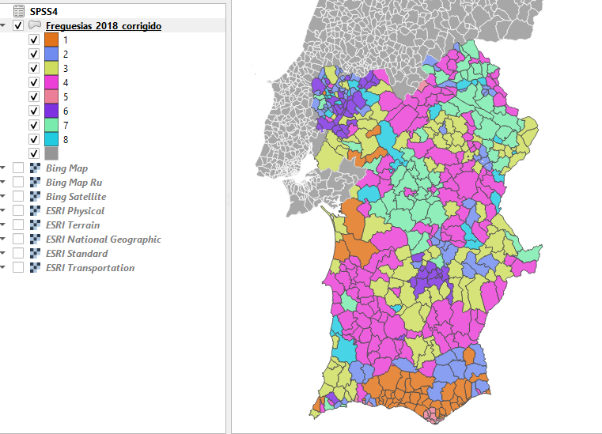
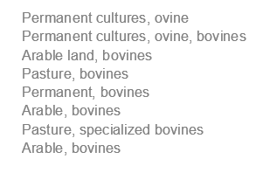
Results- Mapping Farming systems

Slide 18
Main conclusions
We study the Productive Options for Farmers in the South Region – NUTS2 Alentejo and Algarve, using IFAP-Type data
Using visual dendogram analysis (SPSS) and statistical analysis (Statistics-Eta Square and Confidence Intervals Graph, we choose 8 Clusters that best fits our data
Most significant drivers: Availability of irrigation water; Slope <8%; Slope >16%; Higher altitude Gradient; Soil of Reduced Ecological Value; Soil of higher Ecological Value
Importance of Good Quality Data and Access to reliable value chain from collection of the data to the transformation of these data.

Slide 19
Productive Options for Farmers
SOUTH Region (NUTS2 Alentejo+Algarve)
Additional slides

Slide 20
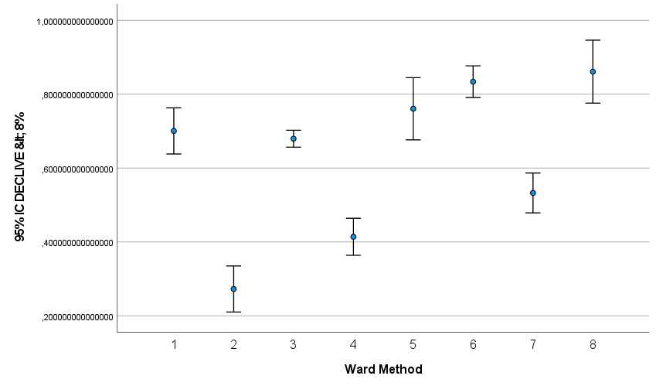
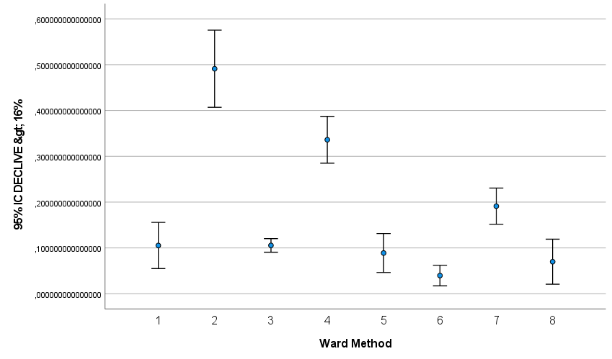
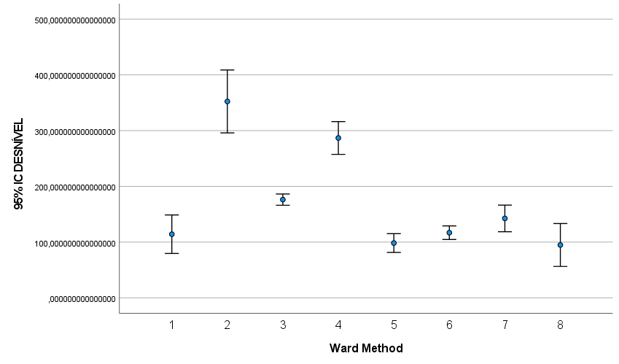
Drivers- Confidence Intervals

Slide 21
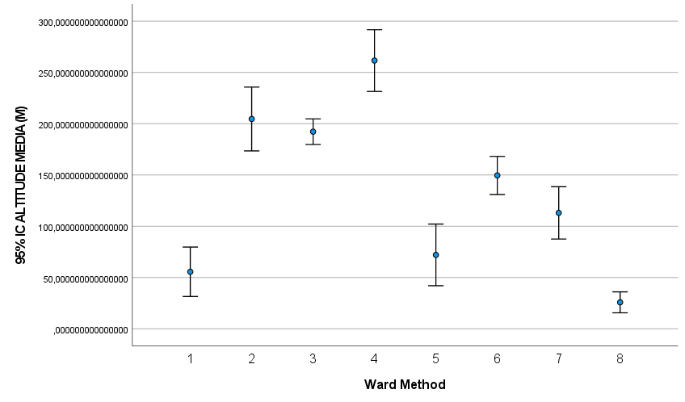
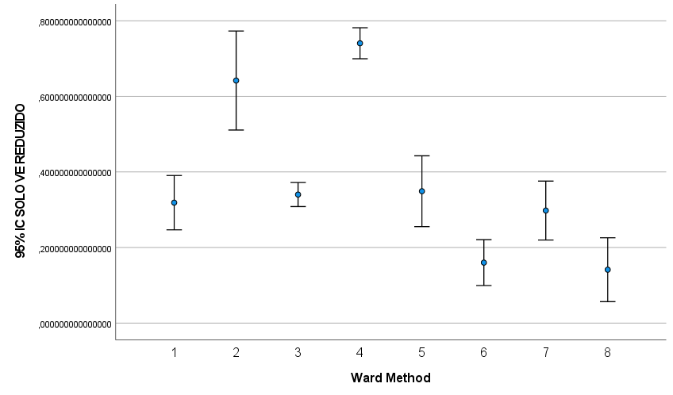
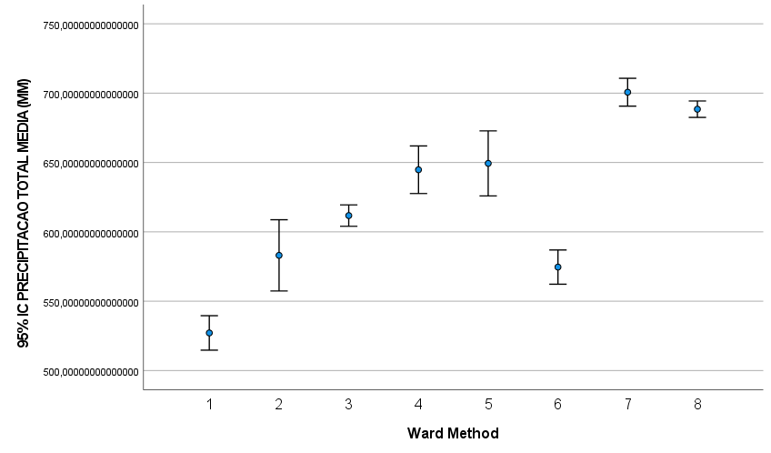
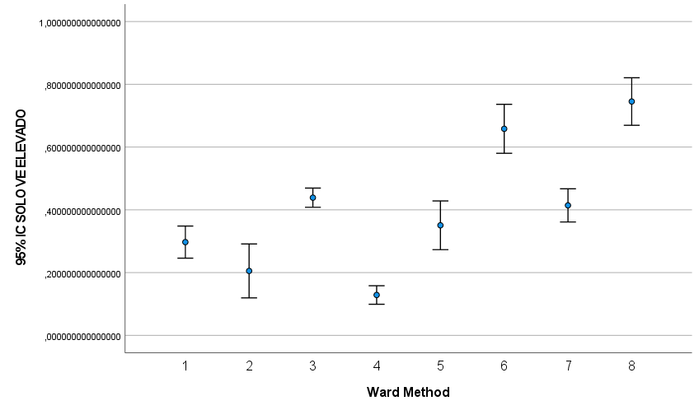
Drivers- Confidence Intervals

Slide 22
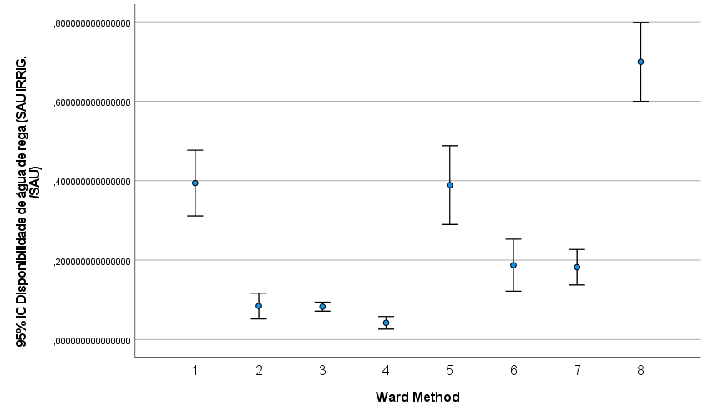
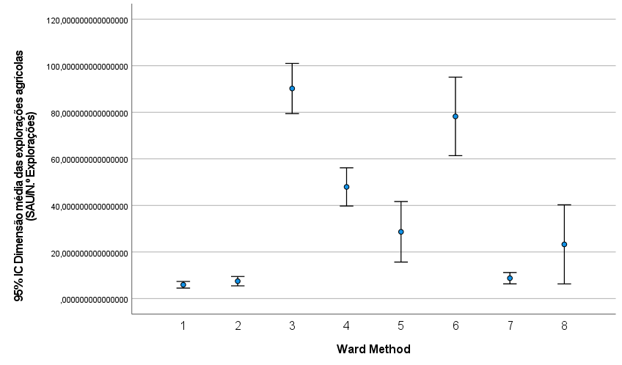
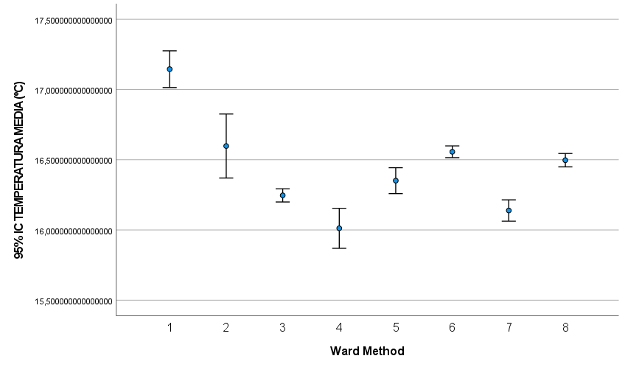
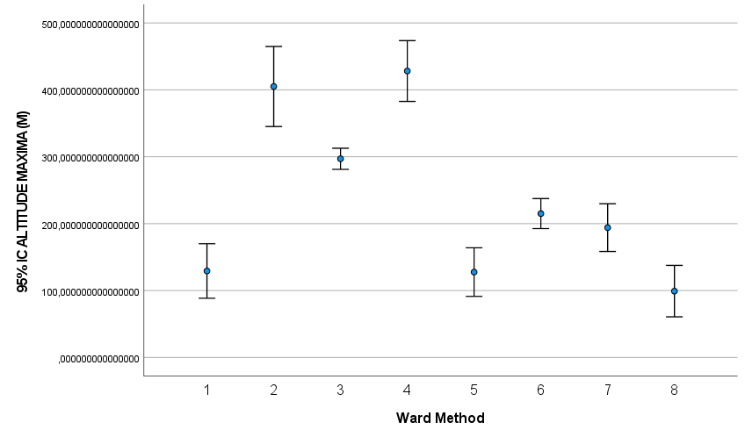
Drivers- Confidence Intervals

Slide 23
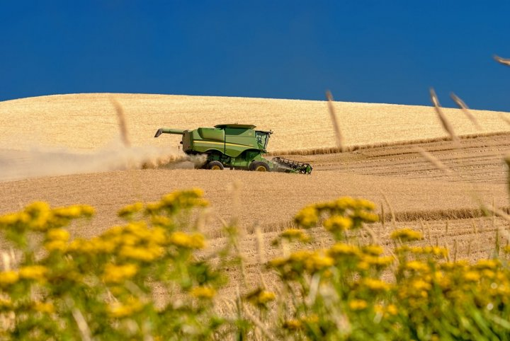
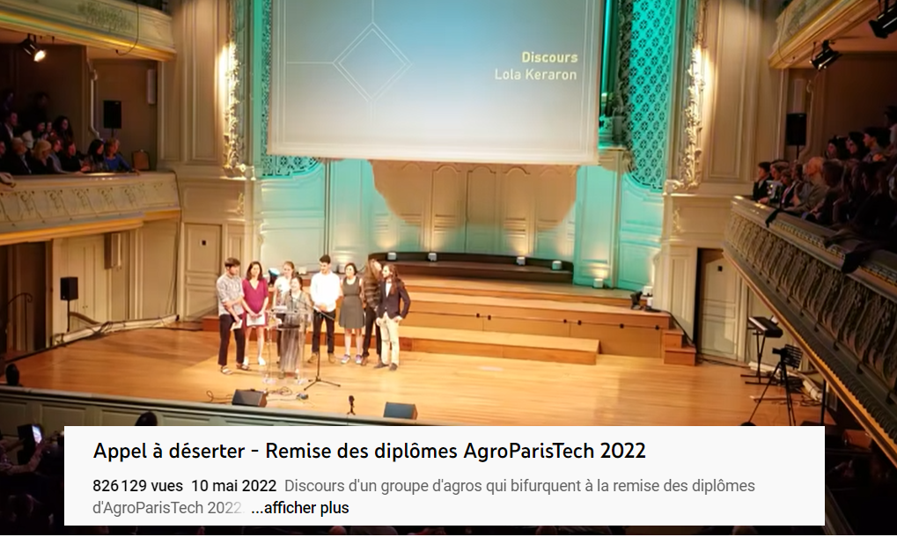
Food for thoughts: tech for good?
“Climate smart agriculture” is a movement led by the FAO and multinationals: it claims to respond to climate change by introducing new technologies in agriculture… but the approach conceals the extension of industrial agriculture.
An example of innovation area is “precision software” to adapt crops to the vagaries of the climate. Bayer, a major supplier of pesticides in the world supports the “rationalization of agricultural practices” thanks to “information and communication technologies”.
Monsanto spent $930 million (854 million euros) last year to buy The Climate Corporation, a "big data" company whose flagship product is an application that allows farmers to receive real, ultra-detailed agronomic and weather information for each of their fields.
Call to desert - AgroParisTech 2022 graduation ceremony

Slide 24
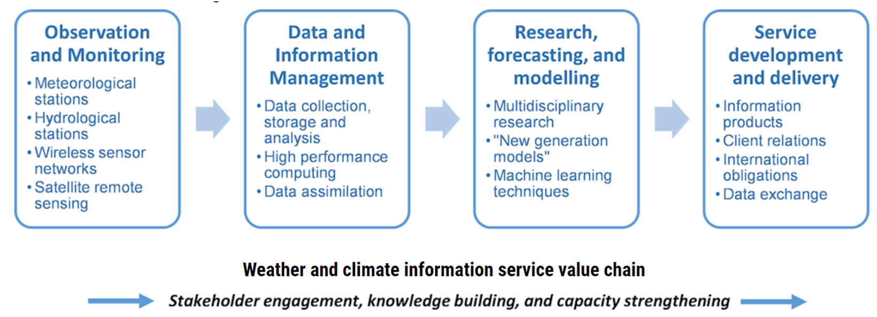
Ideas for further research for optimization of drivers
Hypothesis : Drivers (biophysical and socioeconomic factors) help farmers take the “right” decision for the strategic planning of their land use short and longer term.
=> So the whole value chain from collection of the data to the transformation of these data into information / and knowledge must be of quality.

